Slide 1
A Room Full of Candy
By: Brandi Ripa

Slide 2
Purpose/ Background
Authentic Assessment
Encompasses many skills
Collaborative Groups
Taps into higher levels of thinking
Can be modified to include preferences of students

Slide 3
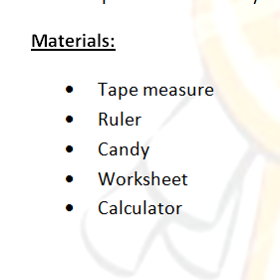
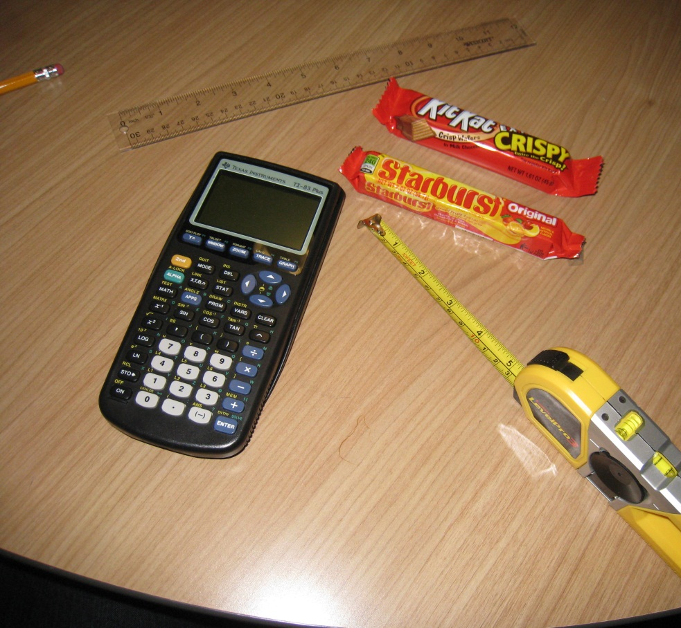
Goal: Students will be able to apply their knowledge of volume, area, and measurements to authentic scenarios.
Objectives:
Using various measuring tools, students will accurately measure various objects.
Using a calculator, students will be able to make conversions between units of measurements.
After finding necessary measurements, students will be able to calculate its volume/area.
Given one dimension, students will be able to use their knowledge of proportions and similar shapes to solve for the other dimensions.
Given the price of one unit, students will be able to find the total price of x units.

Slide 4
Part 1- Data Collection

Slide 5
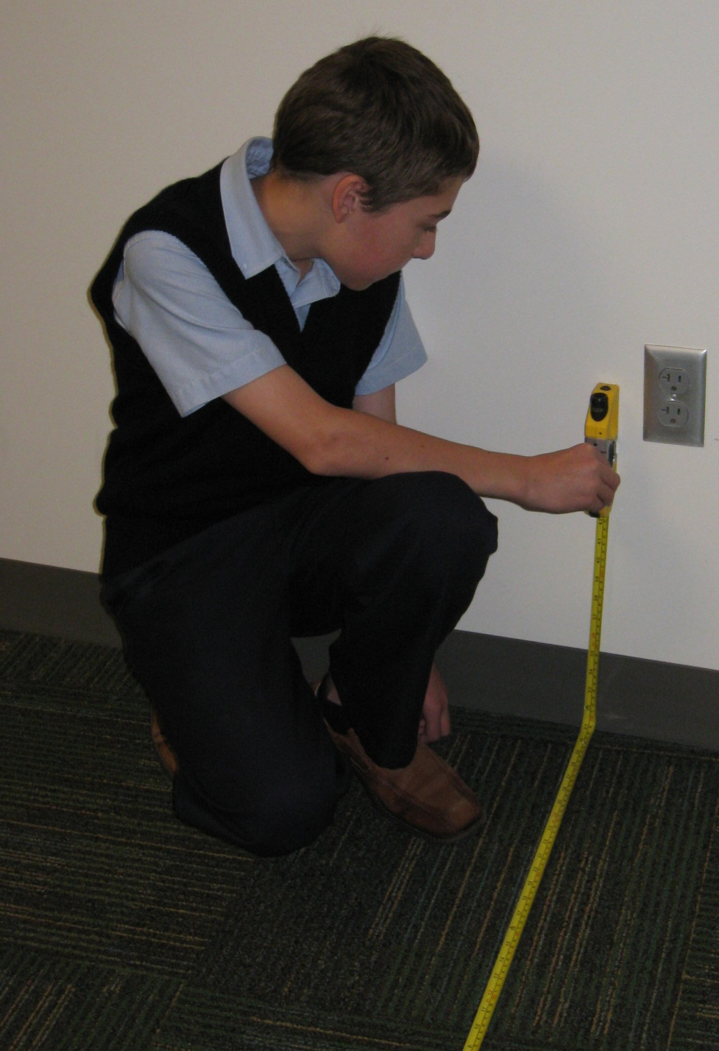
6 in= 0.5 ft
10.25 ft
0.083 ft
12.375 ft
0.083 ft
8.0 ft
0.0034ft³
1,014.75ft³
4

Slide 6
Part 2- Calculations
5. $\frac{Height of wall}{Height of candy}$ x $\frac{Width of walls}{Width of candy}$
3. $\frac{Volume of Room}{Volume of Candy}$
6. Walls $\frac{height}{length}=$Candy $\frac{height}{length}$
Walls $\frac{height}{width}=$Candy $\frac{height}{width}$
4. (# of pieces to fill the room) x $.75
$\frac{1014.75ft^{3}}{.0034 ft^{3}}≈298,455$pieces of candy
$298455$x .75 = $223,841.25
$14304+14304+11808+11808=52,224$ pieces of candy
Height 8ft Length 48.19ft Width 8ft

Slide 7
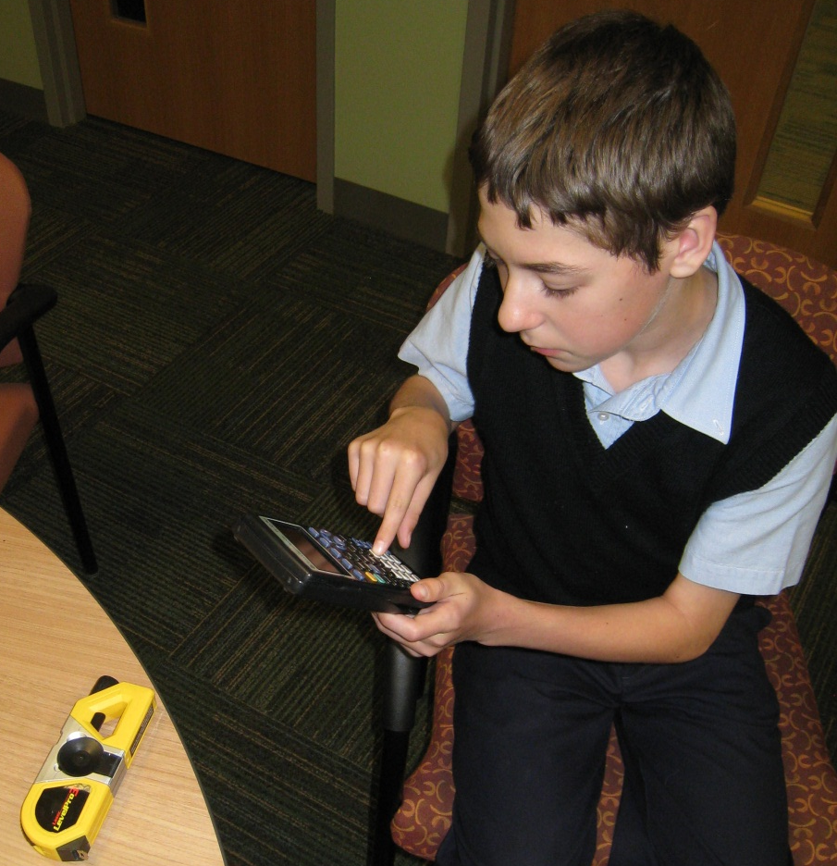
$\frac{12 pieces }{30 seconds}$ = $\frac{298,455 pieces}{x seconds}=207$hours 18 minutes
$\frac{36 pieces }{30 seconds}$ = $\frac{298,455 pieces}{x seconds}=$69 hours 5 minutes
($20 x 207)+ ($2 x 18)=$4,176
7. Crew = 3 members
8. Use same proportion as 7
9. Separate hours from minutes

Slide 8
Part 3- Final Estimate
Write up a final estimate to give the costumer for the work you and your crew will complete in order to fill the room with candy. Be sure to include the cost of materials, cost of labor, expected time frame it will take to complete the job.

